Slide 1
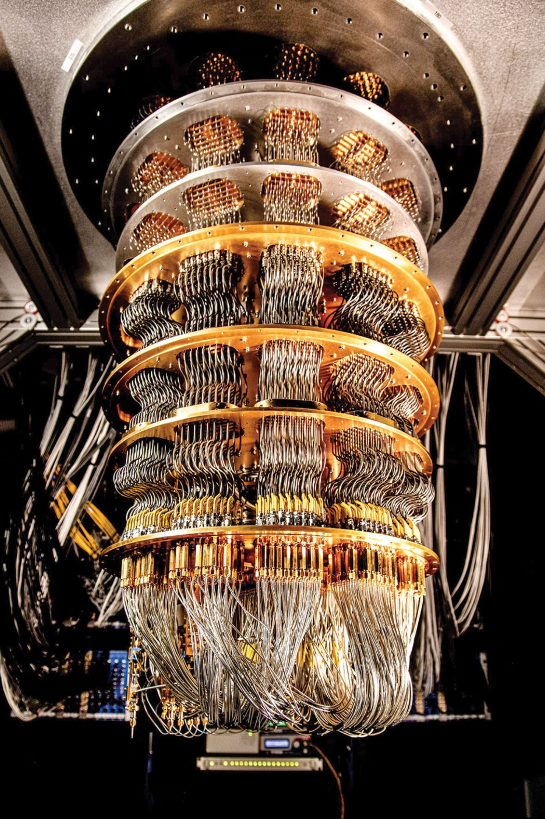
Quantum-Secure Email Client
Building the next generation of encrypted communication with Post-Quantum Cryptography
Team Name: Exit Code 0
PS: SIH107093

Slide 2
Project Mission
Core Objective
Key Deliverables
Develop and deploy a production-ready webmail application featuring custom-implemented Post-Quantum Cryptography (PQC) desktop app for end-to-end encrypted messaging.
Secure backend API with validated PQC module
React-based responsive web client
PostgreSQL data layer with encrypted storage
External email interoperability via OpenPGP/SMTP
This system protects against both current threats and future quantum computing attacks.

Slide 3




Technology Stack Overview
Backend
Cryptography
FastAPI framework with Python
ML-KEM : For encryption
RESTful API architecture for scalability and performance
ML-DSA : For signature verification
Database
Frontend
PostgreSQL with encrypted schemas
React with modern UI components
Secure user and message storage
Responsive design for all devices

Slide 4
Four-Phase Development Timeline
Week 1: Core Systems
Week 3: Interoperability
PQC library implementation, database initialization, and backend API foundation with comprehensive testing
SMTP integration, OpenPGP support, and protocol selection logic for external domain communication
1
2
3
4
Week 2: Integration
Week 4: Production
Frontend development, API integration, and deployment of functional v1.0 for internal PQC messaging
Bug testing, UX refinement, cloud deployment, and optional SMTP listener microservice

Slide 5
Critical Security Challenges
Cryptographic Implementation Security
Side-Channel Attack Prevention
Cross-Domain Email Handling
Protecting against information leakage through power consumption, electromagnetic radiation, or execution timing. Implement constant-time operations and secure memory handling.
Managing encryption protocol selection between internal PQC and external OpenPGP. Must prevent downgrade attacks while maintaining seamless user experience.
Ensuring the custom PQC library is mathematically sound and resistant to known attack vectors. Requires rigorous testing against timing attacks, fault injection, and algebraic vulnerabilities.
Mitigation strategies include encrypted credential storage, adherence to NIST standards, and phased deployment starting with same-domain MVP.

Slide 6
Dual-Protocol Architecture
Internal Communications
External Communications
Post-Quantum Cryptography
OpenPGP + SMTP
ML-KEM (CRYSTALS-Kyber) provides quantum-resistant encryption for messages between users on the same domain.
Standard OpenPGP encryption ensures compatibility with existing email infrastructure for cross-domain messaging.
UI indicators clearly show security level of each conversation.
Protects against future quantum threats and "Harvest Now, Decrypt Later" attacks.

Slide 7




Features already Implemented
SMTP Integration
Desktop Application
Supports different SMTP Email services like Gmail etc.
Cross platform email client desktop application built on ElectronJS
Auto Decryption
PQC Encryption
Supports automatic decryption from saved clients.
Contains 3 different security levels for encryption with PQC as the highest level.
Research Foundation: Built on standards from NIST, NSA guidelines, IETF drafts for OpenPGP-PQC integration, and peer-reviewed lattice-based cryptography research.

Slide 8
Features to be Implemented
Oauth Integration
Quantum Key Distribution (QKD)
Support multiple ways of login using diverse Oauth services.
Right now, our software emulates a key manager instead of QKD.
Quantum Secure Chat Client ??
Media Support
The implementation can be used to create a quantum secure chat client.
Support media sharing by appropriate encryption instead of directly storing it on a centralized server.
Research Foundation: Built on standards from NIST, NSA guidelines, IETF drafts for OpenPGP-PQC integration, and peer-reviewed lattice-based cryptography research.

